Slide 1

Statistical Analysis of Medical Data Final Project
By Sepehr Kalanaki
Feb 1 - 2024

Slide 2
Outline:
Introduction
Experiment setup
Dataset structure
Data visualization and outliers’ removal
Data analysis
Conclusion
1/15

Slide 3
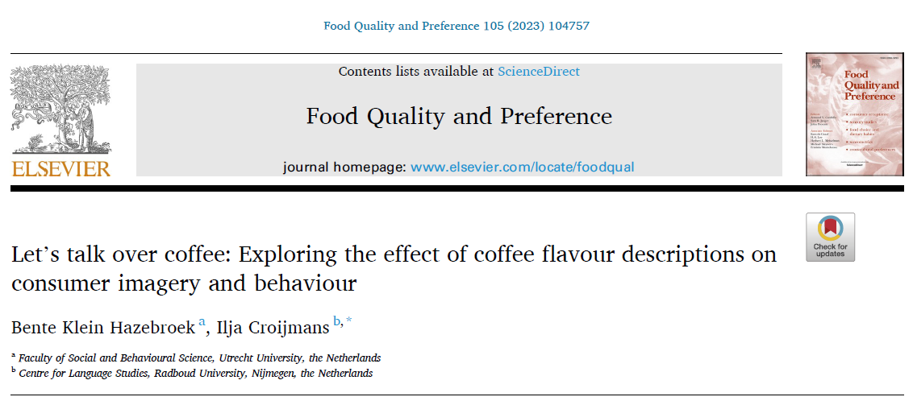
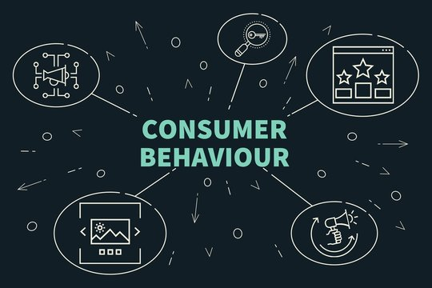

Introduction
Can flavor descriptions influence consumer purchase (coffee) behavior?
2/15

Slide 4
Experiment setup
Subjects are shown 3 different descriptions of 4 kinds of words (5 trials):
Source-based (honey, …)
Abstract (acidic, …)
Evaluative (nice, …)
Combination
Subjects have to answer these 3 questions (3 dependent variables):
Vividness of imagery (VOI): ‘Can you imagine the flavor of this coffee?’ (scale 1–5)
Desire to taste (DTT): ‘Would you like to try this coffee?’ (scale 1–5)
Willingness to pay (WTP): ‘How much are you willing to pay for a bag of 500 g of this coffee?’ (slider £0 - £50)
3/15

Slide 5
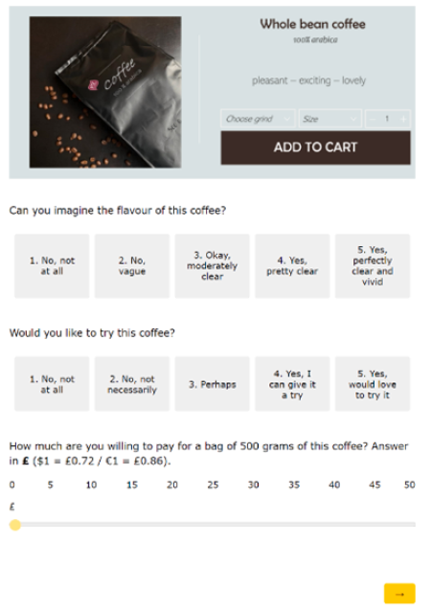
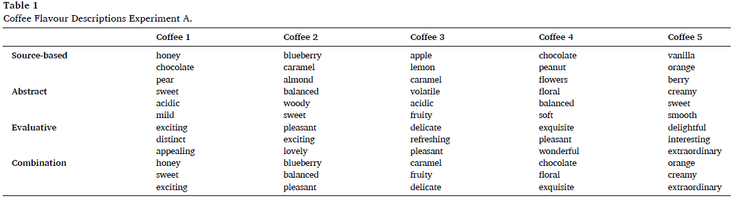
Experiment setup
Screenshot of the online survey
4/15

Slide 6
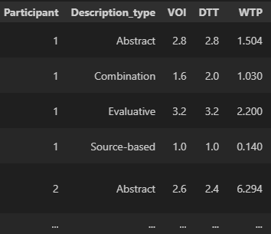
Dataset structure
40 British participants (13 male, 26 female, 1 preferred not to say) aged 19–67 years (M = 34, SD = 12)
Averaged data over trials
5/15

Slide 7
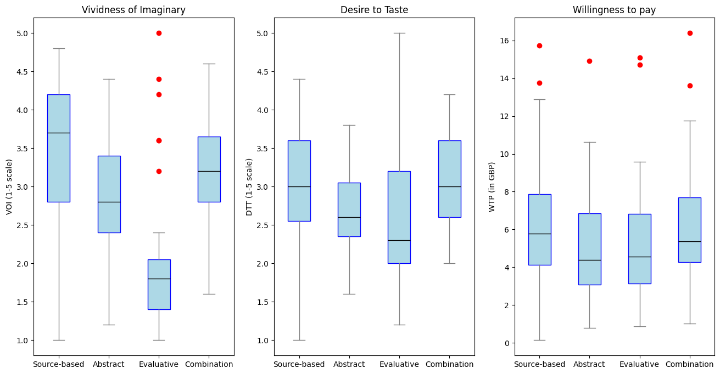
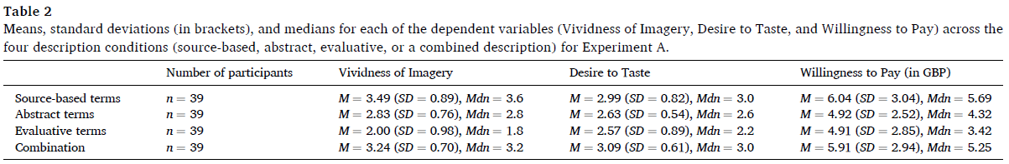
Data visualization
6/15

Slide 8
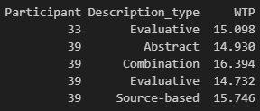
Outliers’ removal
How did they find and treat outliers?
Participants with values in the continuous dependent variable (Willingness to Pay) of more than 3 standard deviations from the mean were treated as outliers and removed.
Let’s remove the data for Participant number 39
7/15

Slide 9
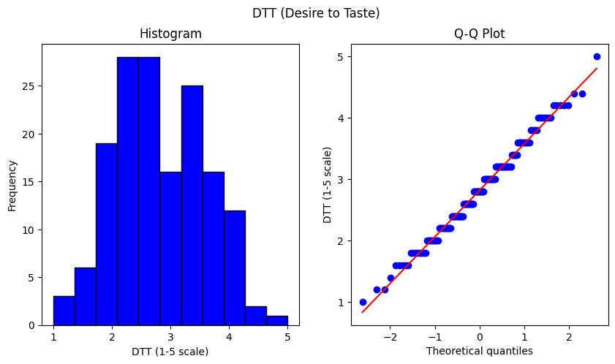
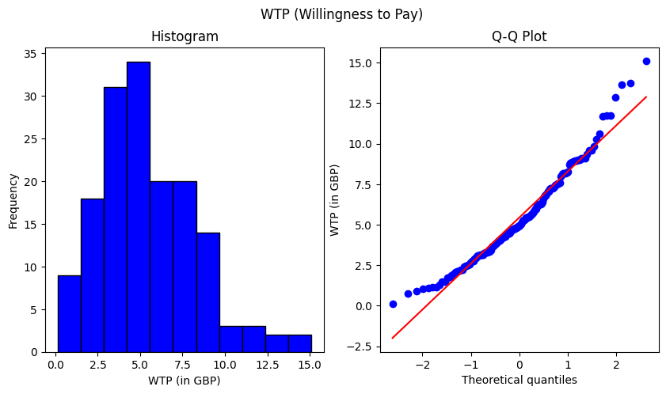
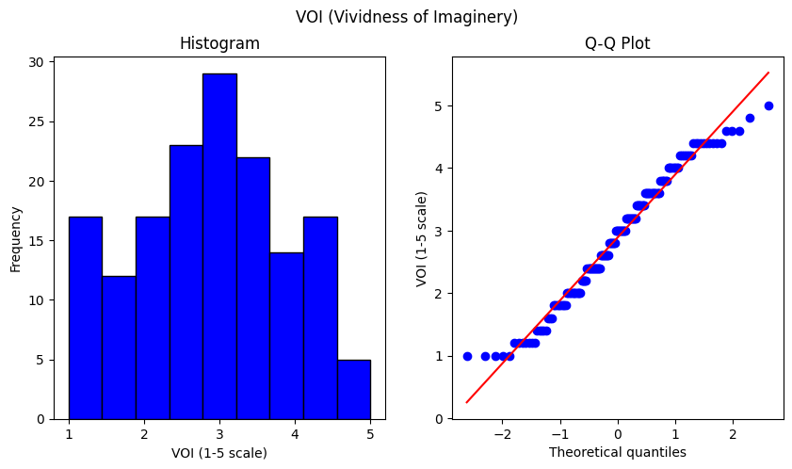
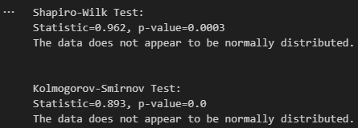
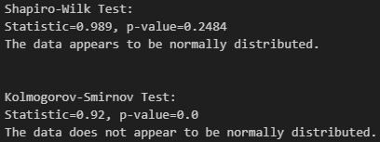
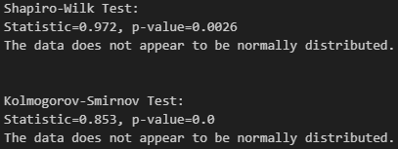
Data Analysis>Normality Check
8/15

Slide 10
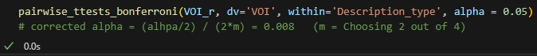
Data Analysis
3 dep measures (VOI, DTT, WTP)
description type as within subject factor
3 repeated-measure ANOVAs/Friedmans
4 kinds:
Abstract, source-based, evaluative, combination
In the case of signiﬁcant main effects, Bonferroni corrected post-hoc pairwise tests were done.
Both the Parametric (t-tests) and the non-parametric (Wilcox pairwise tests).
9/15

Slide 11
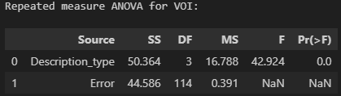
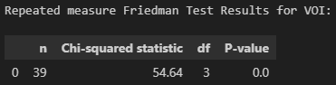
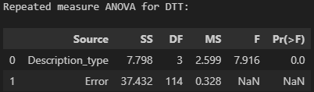
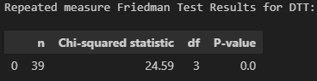
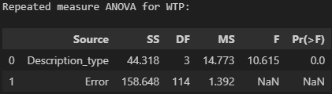
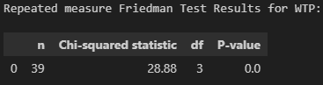
Data Analysis>ANOVA/Friedman Results
Parametric test:
Non-Parametric test:
So there is a significant difference at least between two of the description types for all our 3 variables
Let’s see the result of the Post-hok pairwise tests
10/15

Slide 12
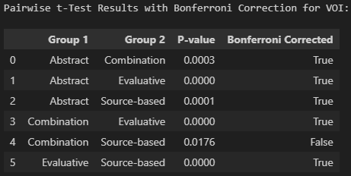
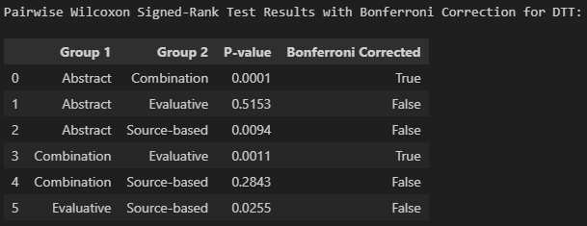
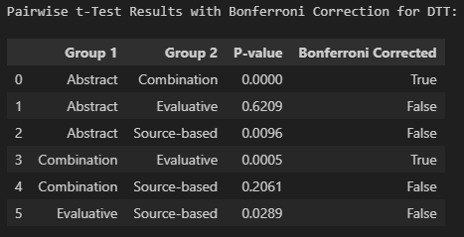
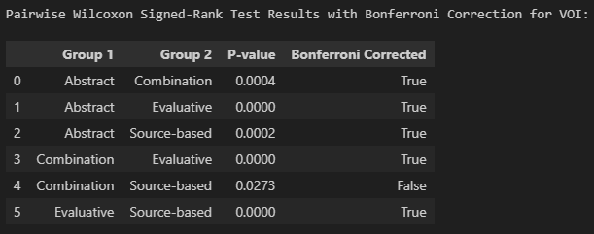
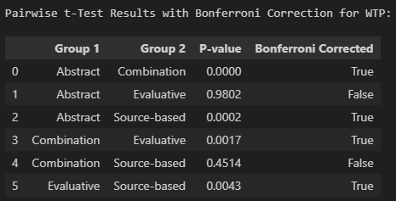

Data Analysis>Post-hok tests Results
Willingness to Pay (WTP):
Desire to Test(DTT):
Vividness of Imaginary (VOI):
Parametric test:
Non-Parametric test:
Only (Abstract & Evaluative) and (Source-base & Combination ) description pairs are not significantly different
Only (Combination & Source-based) description pairs are not significantly different
Only (Abstract & Combination) and (Evaluative & Combination ) description pairs are significantly different
11/15

Slide 13
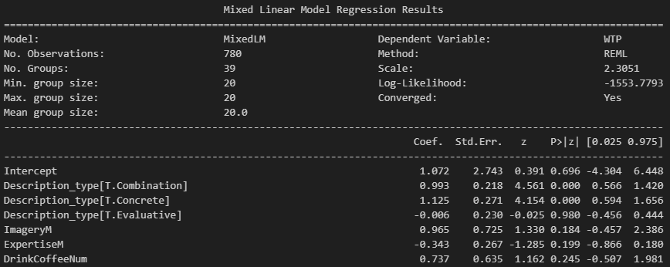
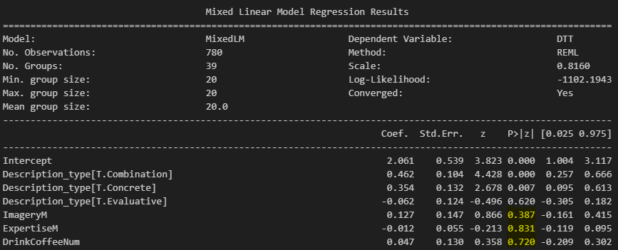
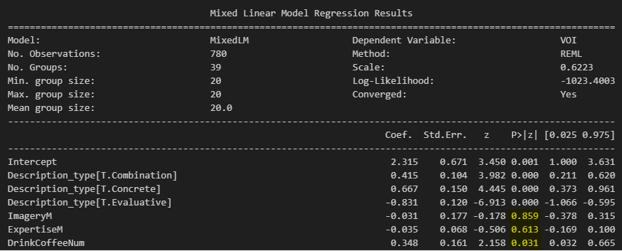




Data Analysis>Linear mixed model regression fit results
This model uses the data of the trial-wise dataset
39 subjects * 4 description_types * 5 coffees (trials) = 780 (number of observations)
Vividness of Imagery (VOI) was influenced by the Frequency of Drinking Coffee
Drinking one more coffee per day increased Vividness of Imagery by 0.348
Willingness to Pay (WTP) was not influenced by the self-reported measures
Desire to Test (DTT) was not influenced by the self-reported measures
12/15

Slide 14
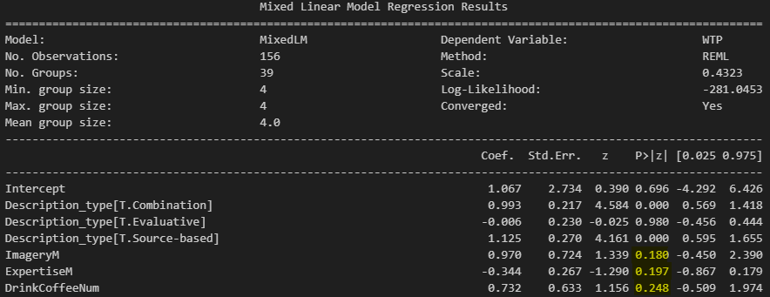
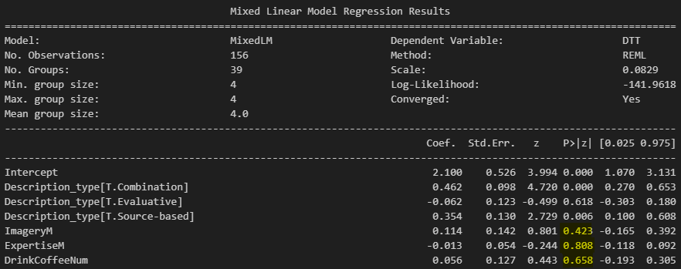
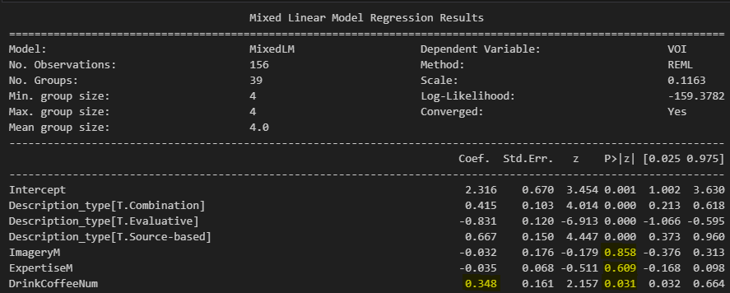
Data Analysis>Linear mixed model regression fit results
How about using the averaged data?
Number of Observations = 39 subjects * 4 description_types = 156
13/15

Slide 15
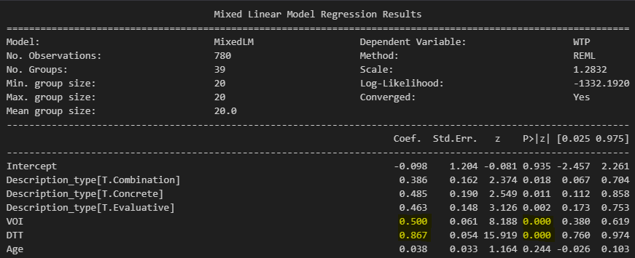
Data Analysis>Linear mixed model regression fit results
Regression analysis, predicting WTP from VOI and DTT with age as covariate
In Other words:
How about the influence of Vividness of Imagery (VOI) and Desire to Taste (DTT) on Willingness to Pay (WTP)?
VOI is significantly related to WTP, with WTP increasing by 0.50 GBP for each point increase in VOI
DTT is also related to WTP, with WTP increasing by 0.86 GBP for each point increase in DTT
The covariate Age was not related to WTP
14/15

Slide 16






Conclusion
The vividness of imagery and desire to taste affect the willingness to pay for coffee and these in
turn are influenced by the descriptions of those coffees.
Using a combination of the 3 description types resulted in the highest amount of VOI, DTT & WTP
Consumers can imagine concrete flavor words most vividly.
This experiment (A) was just based on words! There is another experiment (B) that is based on short
sentences. That will probably work better.
15/15

Slide 17


